Slide 1
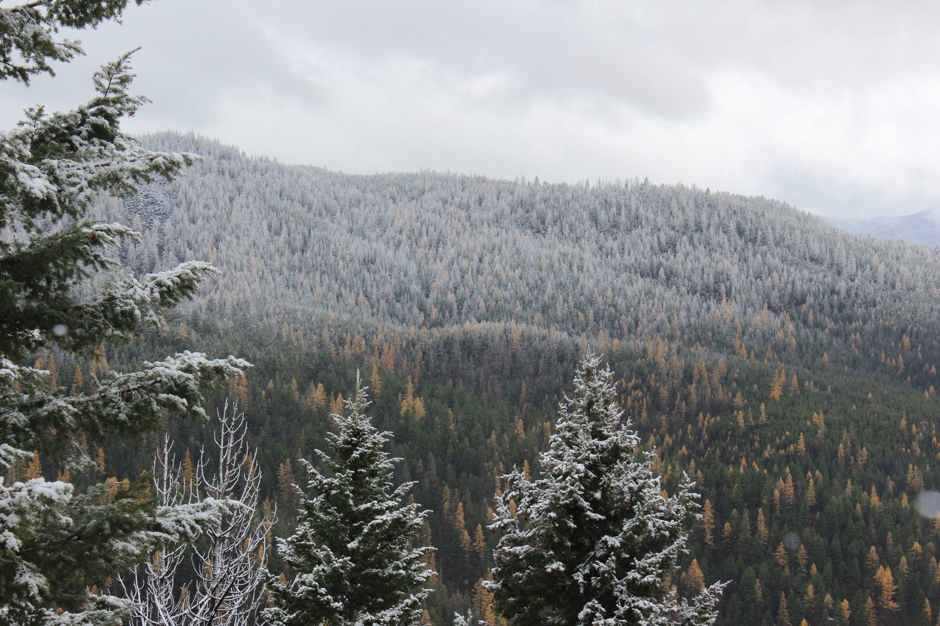
The Influence of Hydroclimate and Harvest Method on Rates of Forest Regrowth across the Western U.S
Zachary H. Hoylman ^{1,2*}, Kelsey Jencso ^{1,2}, Vince Archer ³, James (Andy) Efta ³, Zackary Holden ³, Ashley Ballantyne ², Marie Johnson ²
¹Montana Climate Office, University of Montana, Missoula, MT 59801
²Department of Forest Management, University of Montana, Missoula, MT 59801
³USDA Forest Service, Northern Region, Missoula, Montana 59807

Slide 2
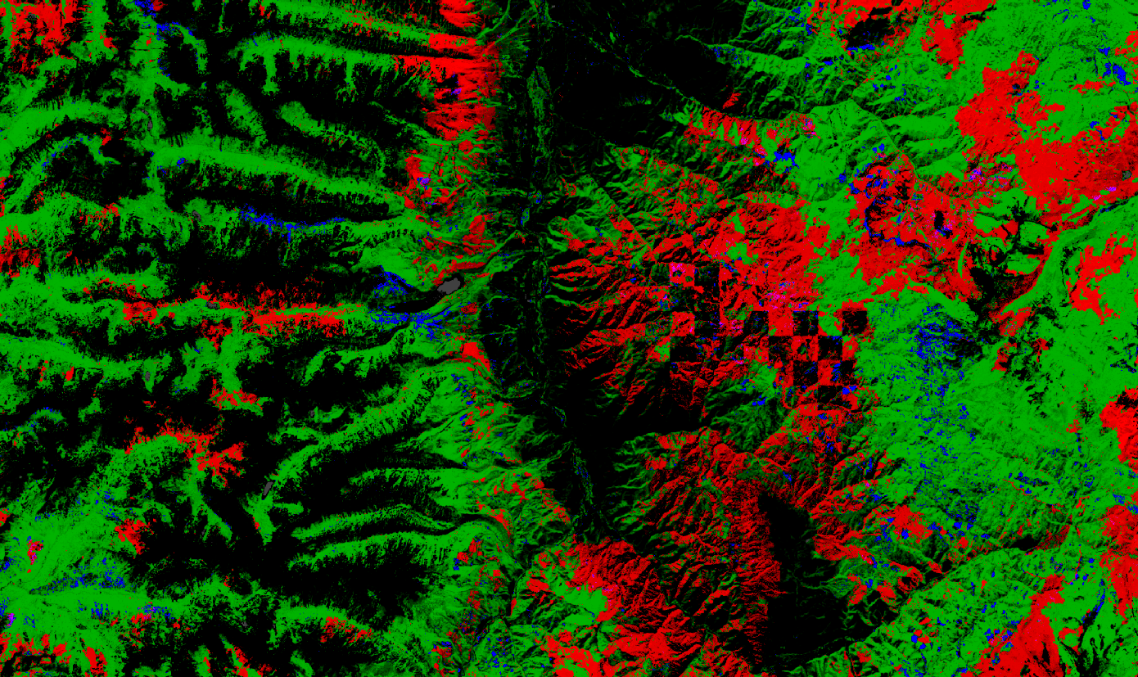
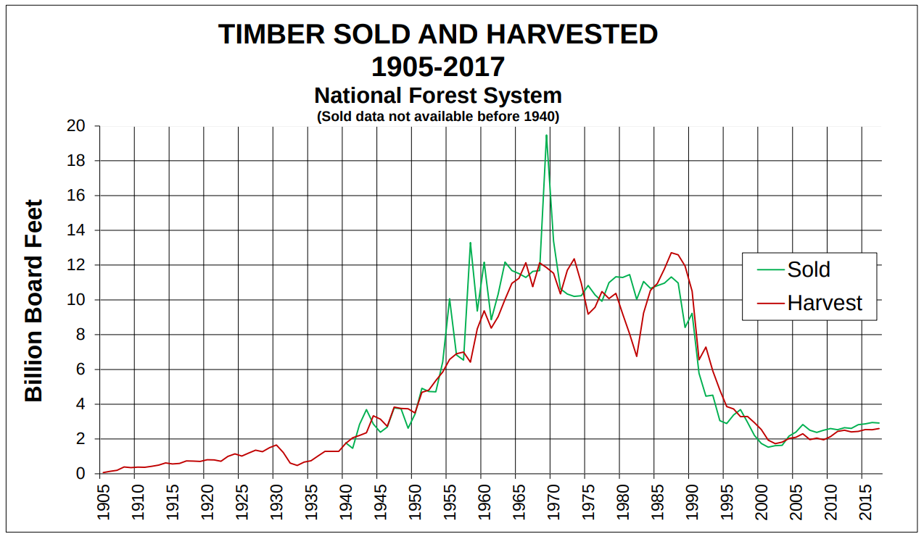
Forest Harvest Across the U.S.
How quickly does forest productivity recover following harvest?
How do climate and silvicultural treatment interact to influence these rates?
Forest products industry accounts for
~1 million jobs annually¹
~6 percent of the total U.S. manufacturing GDP¹
USDA Forest Service: FY 1905-2017 National Summary Cut and Sold
¹Oswalt and Smith, 2014
Hansen et al., 2013
Notes:
The forest products industry is an important component of the U.S. national economy
It accounts for 1 million jobs annually and ~6 percent of the total U.S. manufacturing gross domestic product
This plot shows Billions of Board Feet harvested and sold across nation forest lands from 1905-2017
As you can see, forest harvest dynamics increased steadily throughout the 20th century to reach a maximum in the late 80’s and early 90’s
Forest harvest in conjunction with other ‘disturbance’ including fire, insect infestation, etc have generated a mosaic of forest change across the landscape.
This is a map showing forest change based on Landsat data from Hansen 2013. Let’s zoom into a region in western Montana.
As you can see, forest change, and specifically forest loss (shown in red) follows a complex spatial pattern driven by topography, climate and management boundaries.
While there is alot of red on this map, not all of this red shows locations with permanent forest loss, in many areas forests are bound to recover
However it is unclear how quickly forest productivity recovers across diverse environmental conditions and in response to differing management decisions
Regeneration of forests is a critical consideration in current forest harvest practices.
Infact, existing law and regulation requires forest regeneration after timber harvest for federal agencies
Therefore it is important to quantify the spatial and temporal patterns of forest regeneration following silvicultural treatments across the landscape.
Which brings me to the core questions at the root of this research:

Slide 3
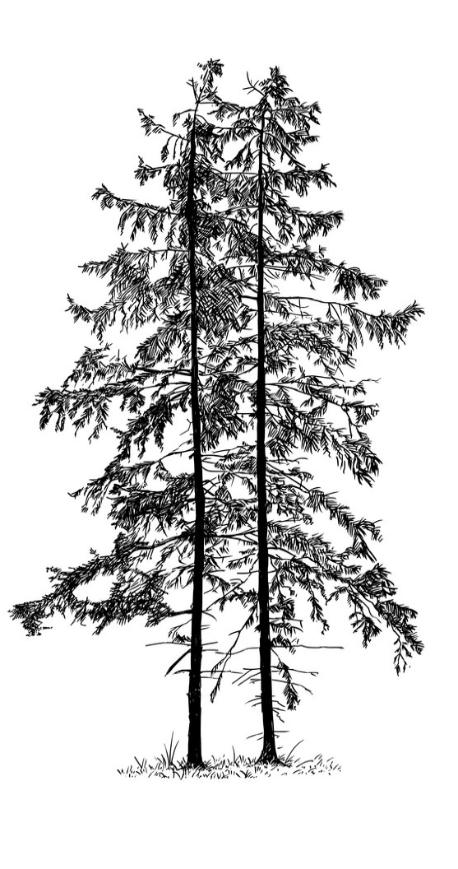
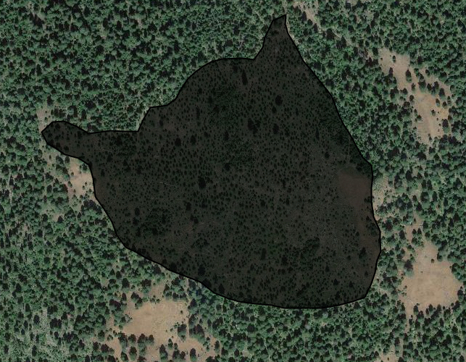
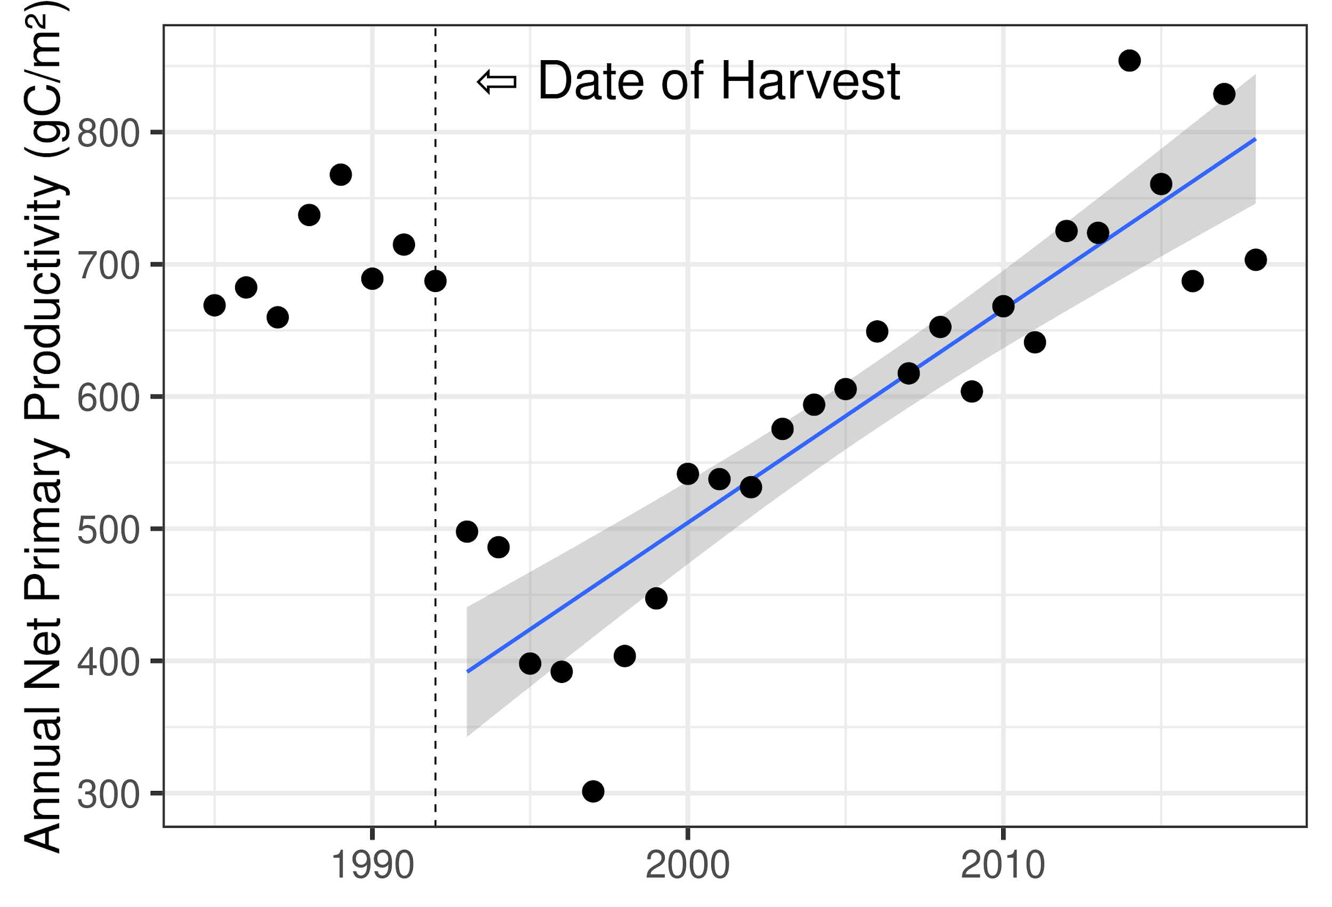
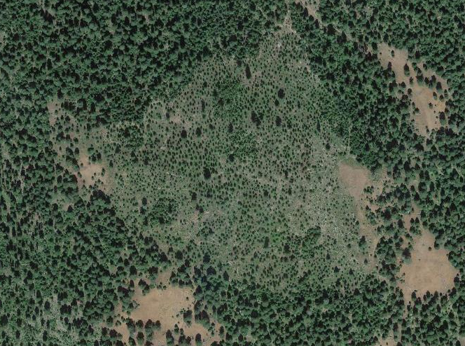
Datasets:
FACTS database (USFS) for geospatial & temporal boundaries of forest harvest
High spatial resolution (30m) net primary productivity (NPP; gC m⁻² y⁻¹)
CONUS wide 1986-2019 (Robinson et al., 2018, Landsat MOD 17)
FACTS
Notes:
To address these questions we are going to utilize a series of datasets and analysis.
Forest Activity Tracking System

Slide 4
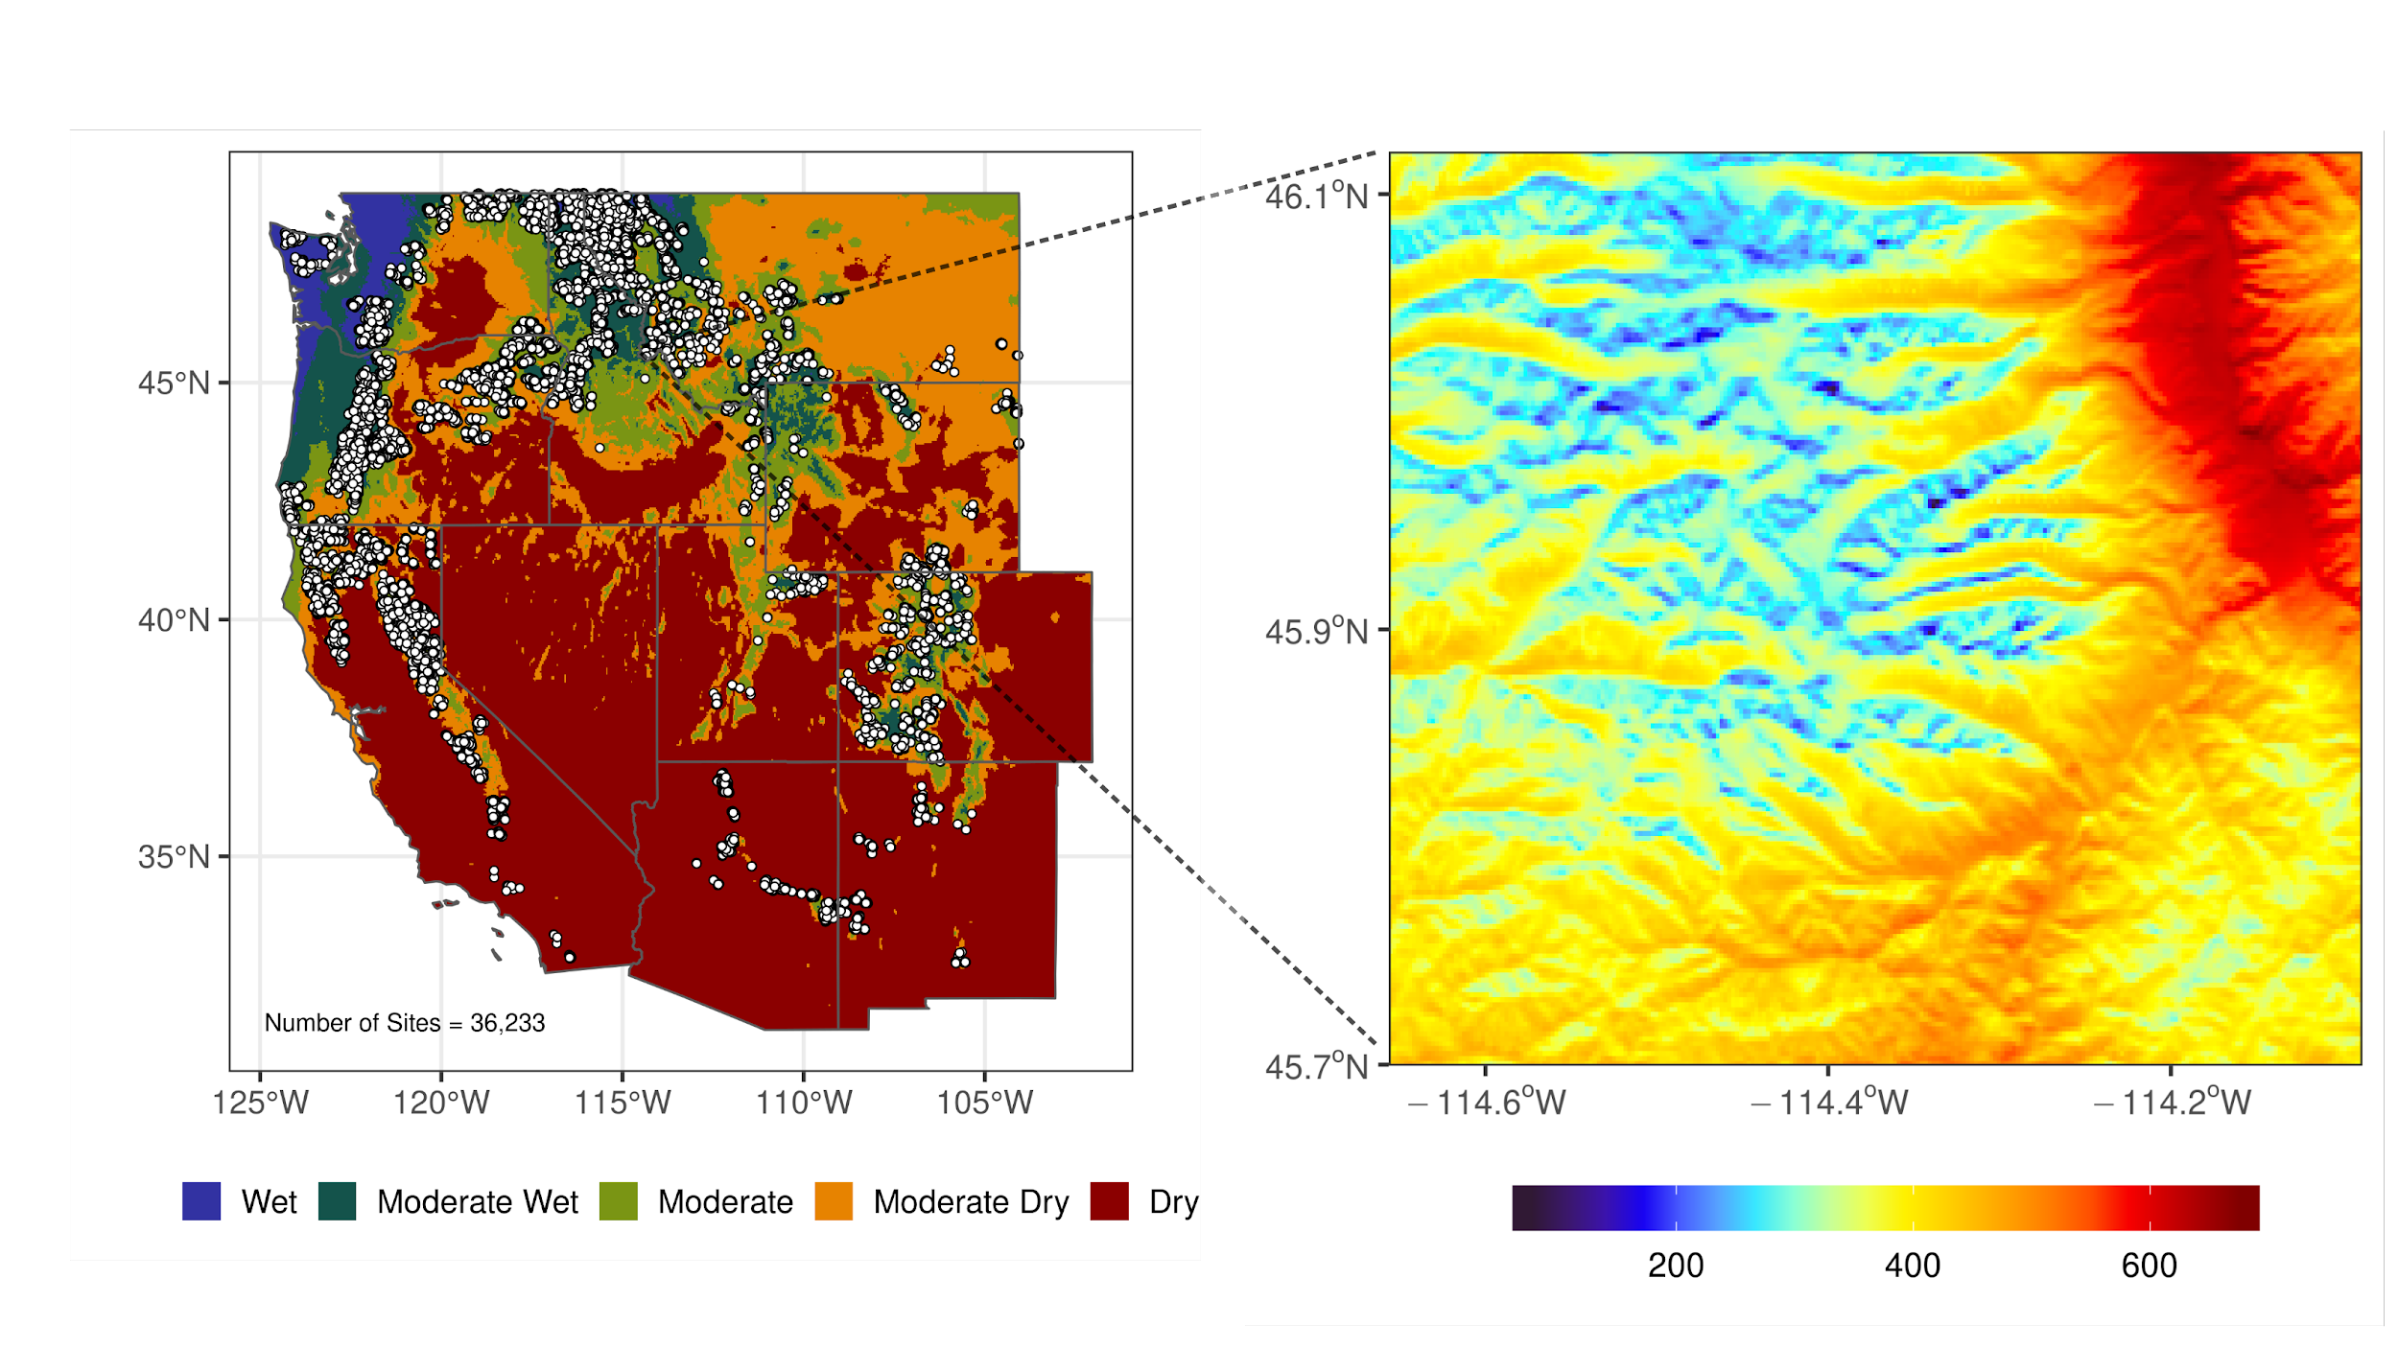
Climatic Water Deficit = Potential ET - Actual ET
CWD represents the unmet atmospheric demand for moisture (Holden et al., 2019)
Computed at a 250m resolution (topographically resolved) at a daily time step

Slide 5
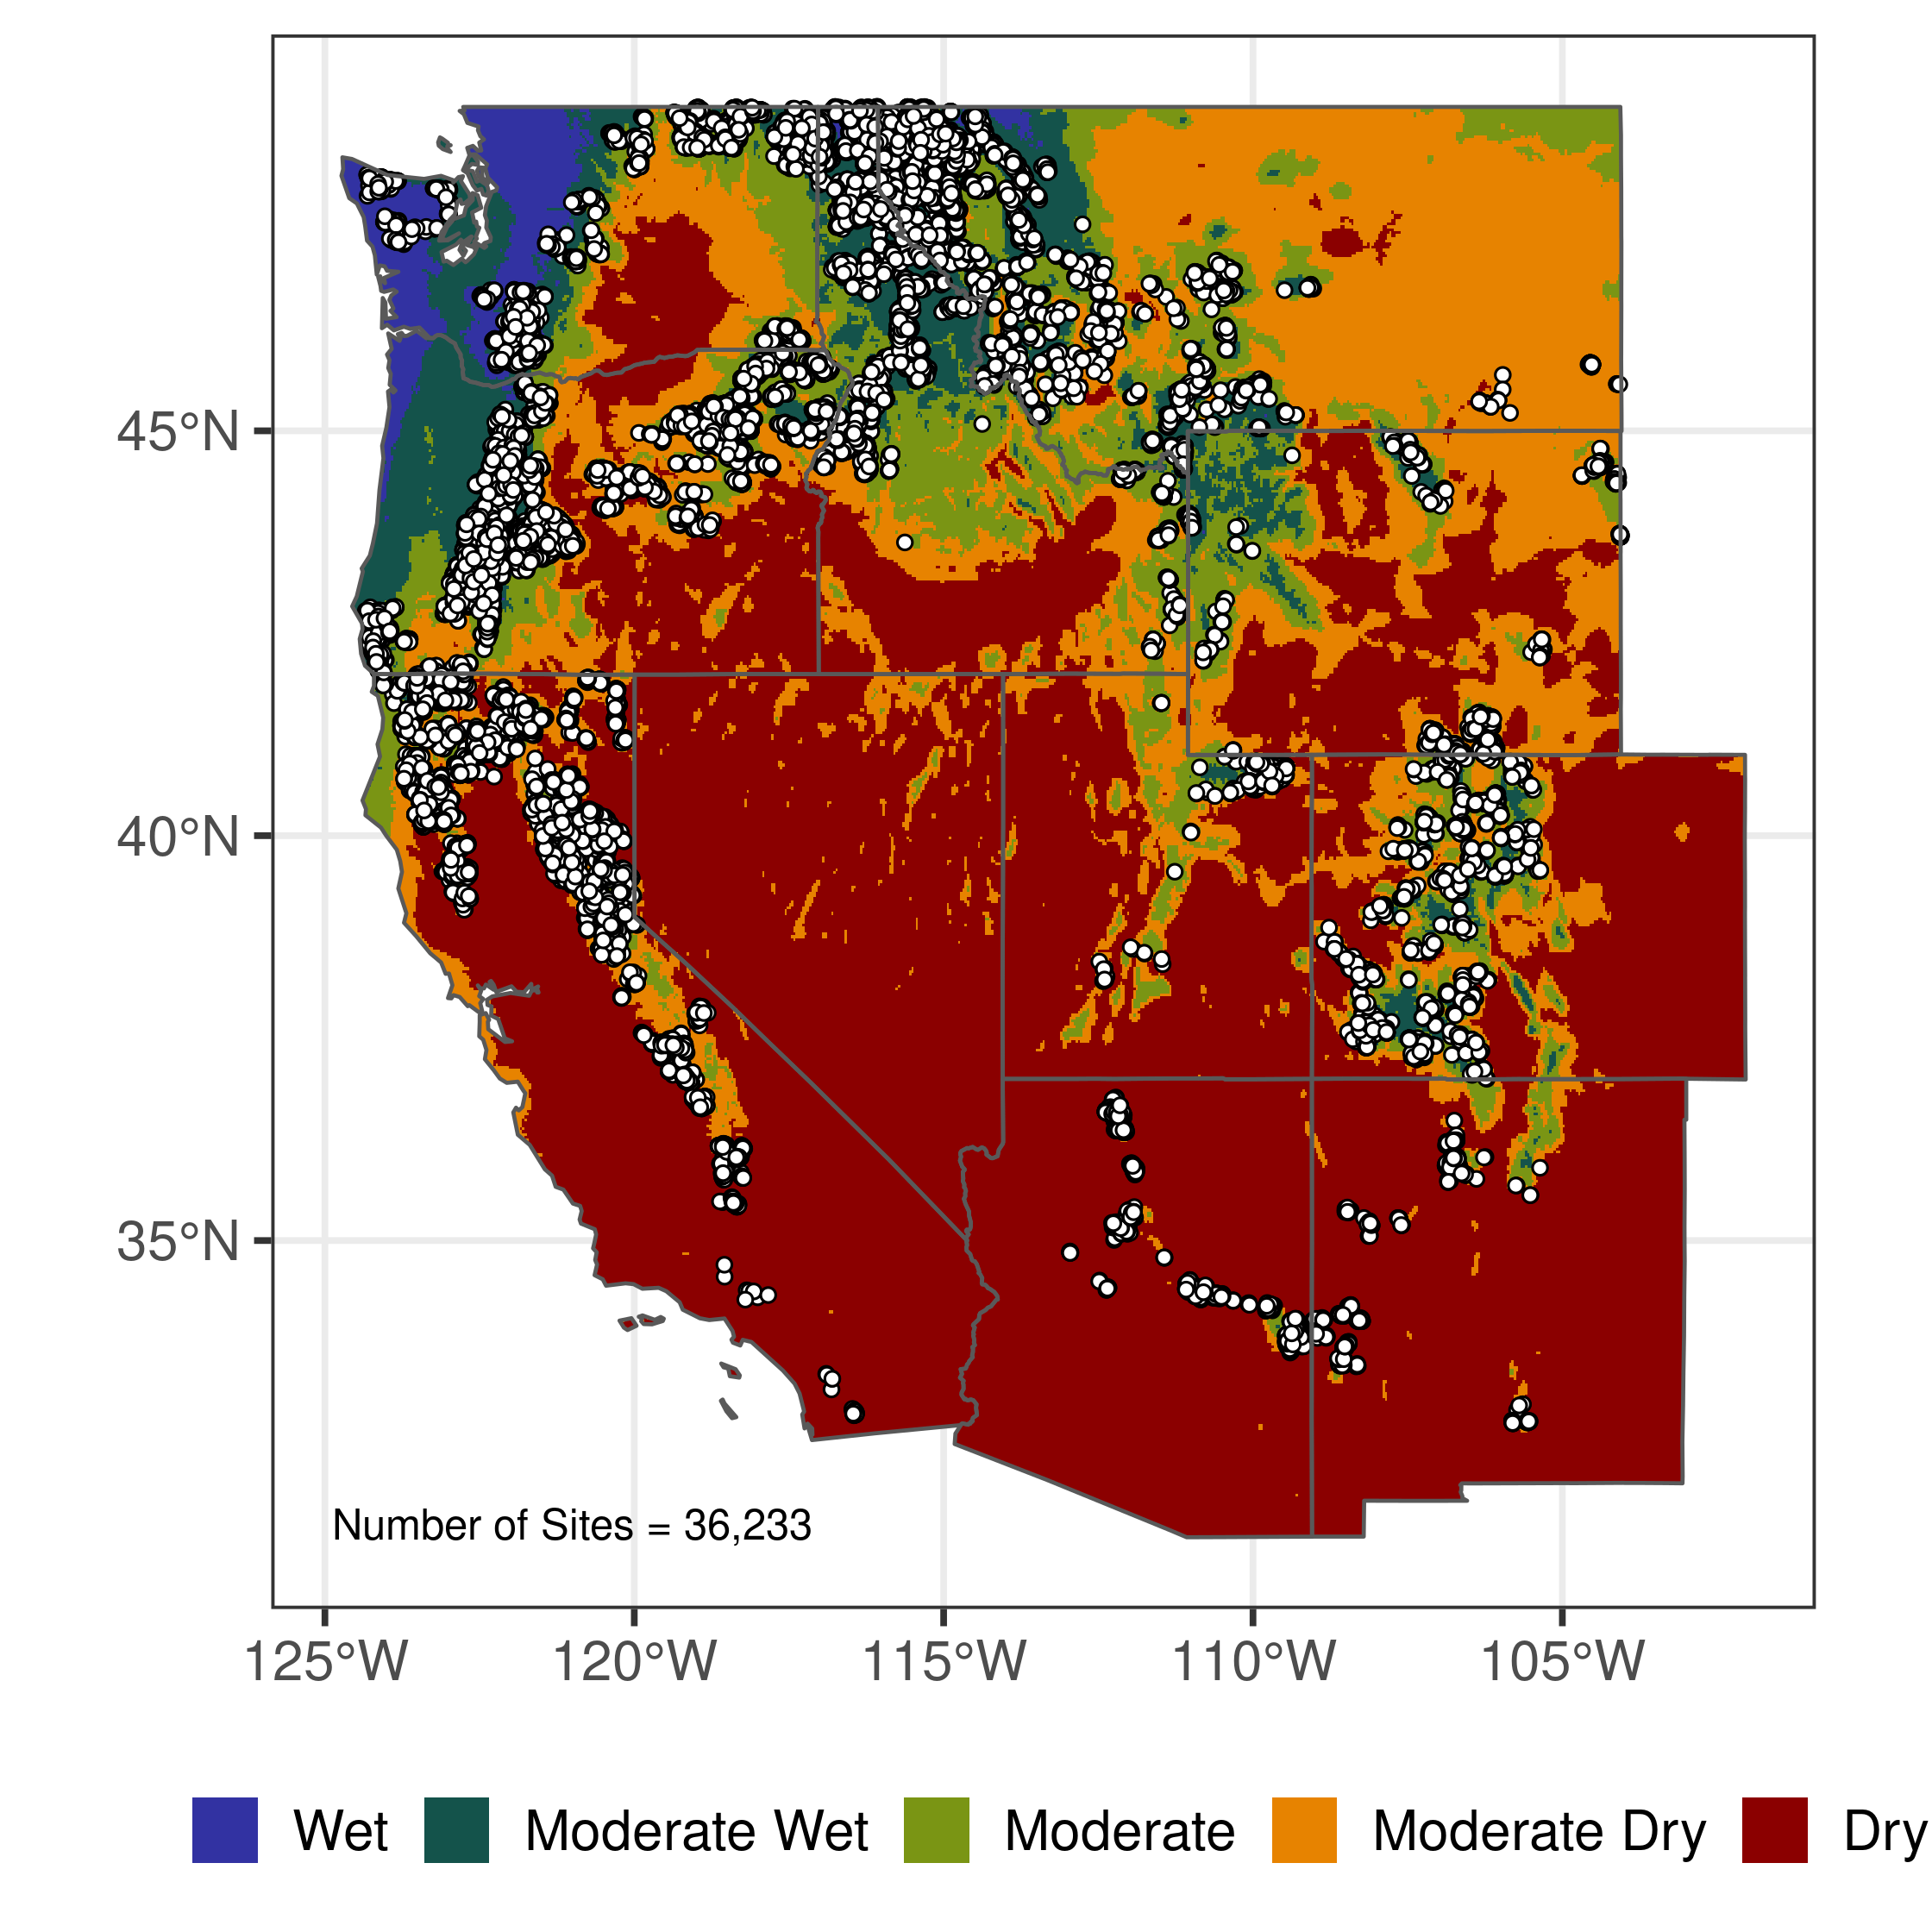
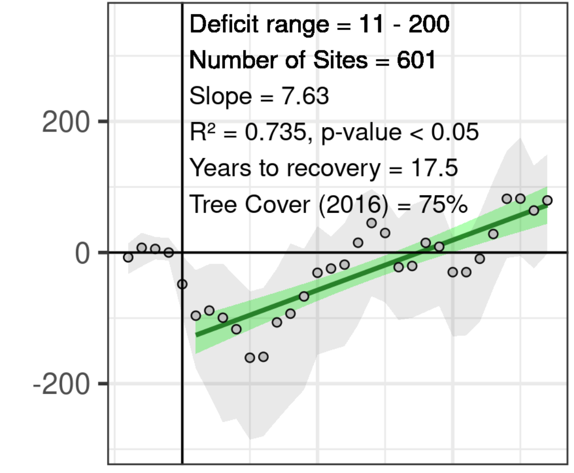
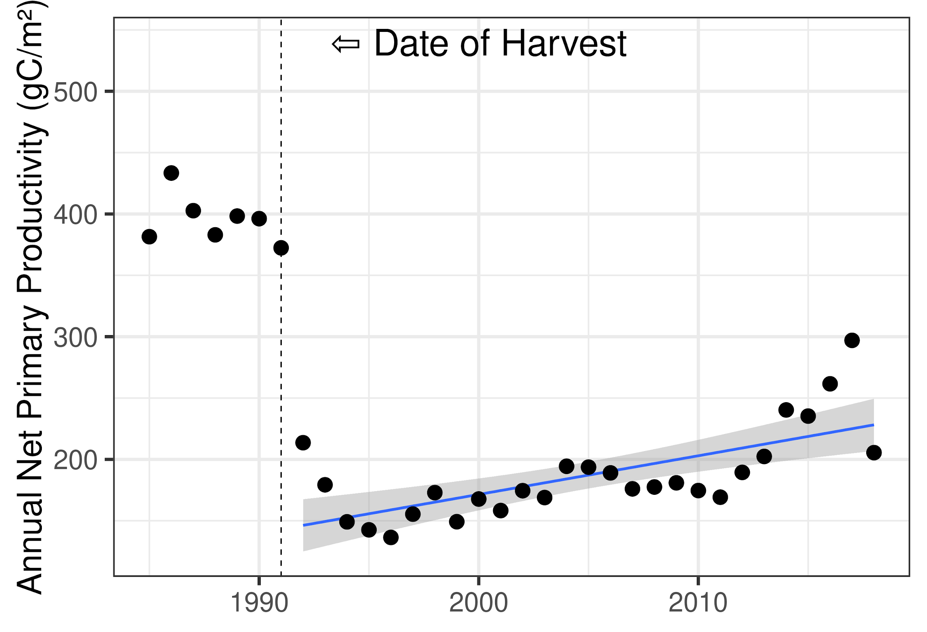
Methods:
Extract NPP time series for forest harvest boundaries that occurred between 1990-1992 (>36,000 locations)
Normalize NPP based on site specific pre-harvest productivity
Classify treatments based on silvicultural strategy (focus on 6 most common) and climatic class (5 climate classes, Wet -> Dry)
Estimate regrowth using trend analysis of post-harvest NPP
Site Specific Response
Generalized Response
Relative NPP
0 10 20
Years Since Harvest

Slide 6
WET Hydroclimate DRY

Slide 7
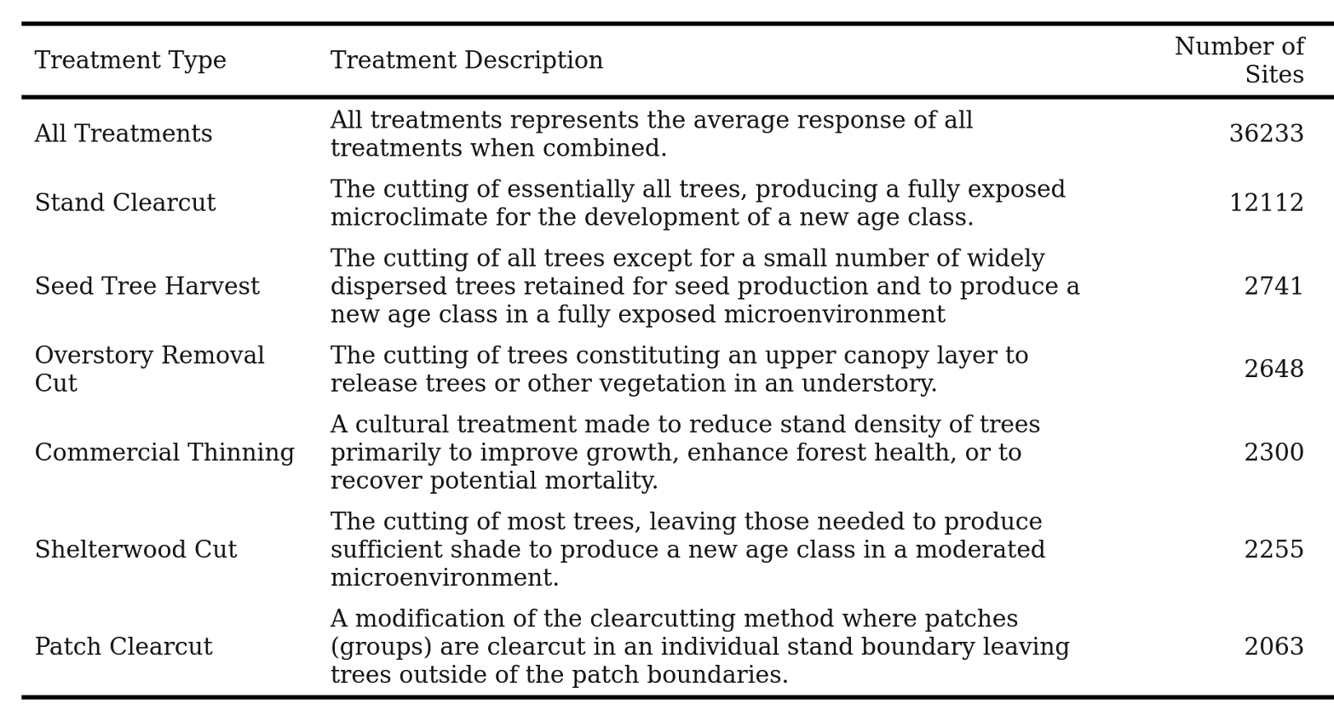
Climate
Replicated this analysis for each silvicultural treatment / climate class
Treatment

Slide 8
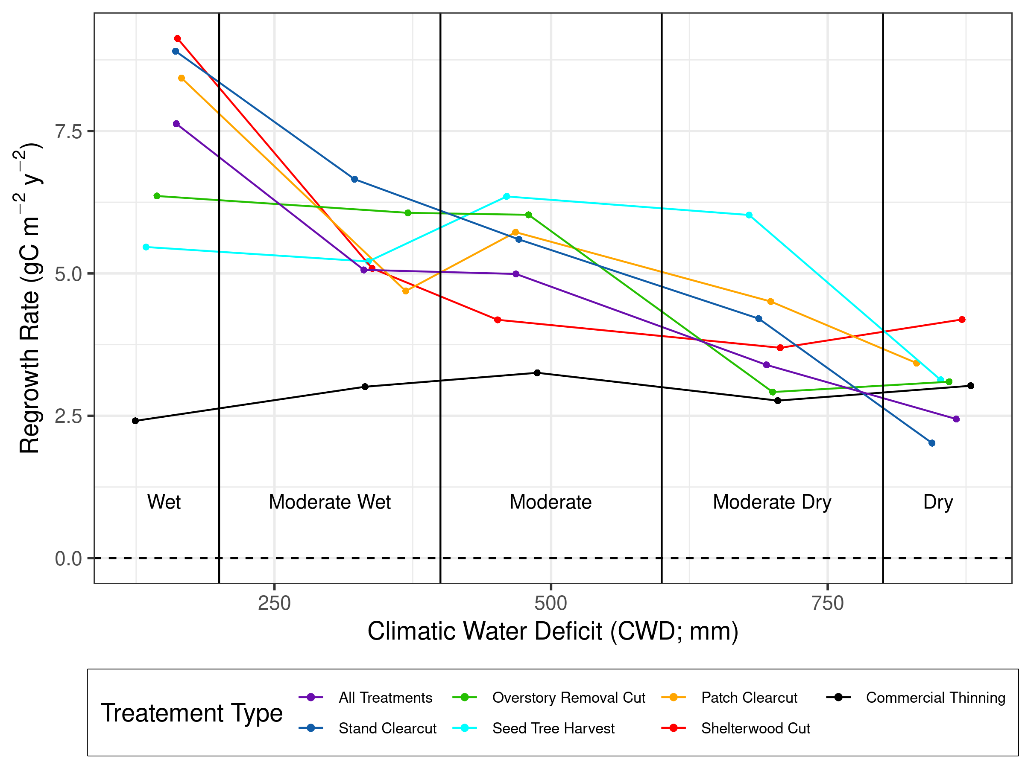
* All effects are statistically significant
Comparison of regrowth rates
Climatic Effect*
Treatment Effect*

Slide 9
Identification of maximum regrowth rates
But what about additional treatments?
What about planting of seedlings?

Slide 10
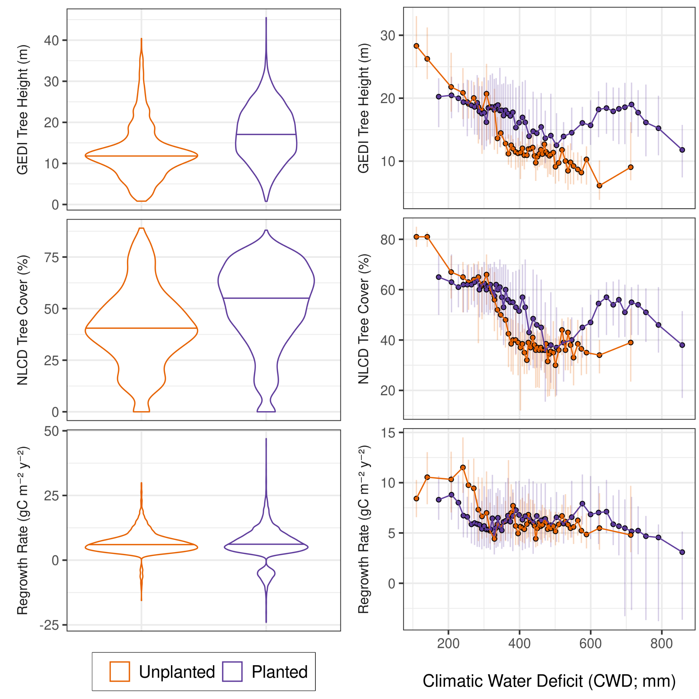
To Plant or Not To Plant?
In wet climates, planting is associated with a shorter, less dense forest 30 years later with a slower regrowth rates.
In moderate to dry climates, planting is associated with a taller, more dense forest 30 years later with a faster regrowth rates.

Slide 11
Key takeaways:
Both climatic setting and silvicultural treatment are critical for determining rates of forest regrowth
Microclimates produced by treatments can enhance (dry shelterwood, wet clearcut) or restrict (dry clearcut) rates of regrowth
Natural seed sources seem to be effective in moderate climates (moderate seed tree)
Management occurs on a diverse landscape where 1 management strategy may not be appropriate everywhere.
Planting seems to have a variable influence
As climate shifts, we can approximate future rates of regrowth and suitable management options.

Slide 12
The Influence of Hydroclimate and Harvest Method on Rates of Forest Regrowth across the Western U.S
Thank You!

